Slide 1
Stronger Together Webinar Series
Welcome! We'll be getting started in a few minutes.
https://cvnl.org/
Recording & slides (English/Spanish) will be available at cvnl.org
1

Slide 2
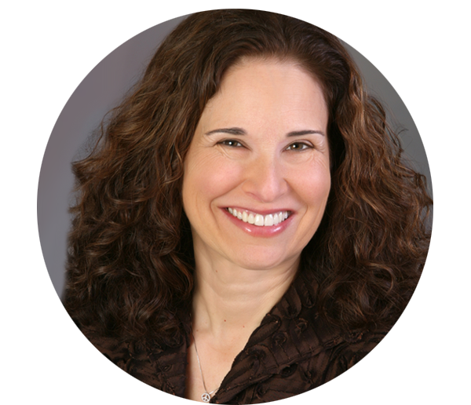
Mental Health and Employee Well-Being During Covid-19
Stronger Together Webinar Series
Moderator
Linda Jacobs, CEO Center for Volunteer & Nonprofit Leadership
Recording & slides (English/Spanish) will be available at cvnl.org

Slide 3
Stronger Together Webinar Series
https://cvnl.org/
Recording & slides (English/Spanish) will be available at cvnl.org
3

Slide 4
Support for this webinar generously provided by…
Ginnie & Peter Haas Jr. Family Fund,
Marin Community Foundation, Community Foundation Sonoma County, and Solano Community Foundation
4

Slide 5
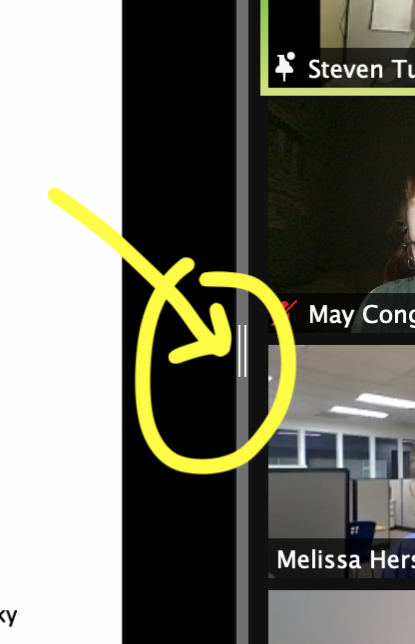
Tech Tips
View tab: Adjust your view to see the whole group, or just the active speaker
Shared screen: When a screen is shared, drag the divider to view more people at once
Recording & slides will be available after the presentation at cvnl.org

Slide 6
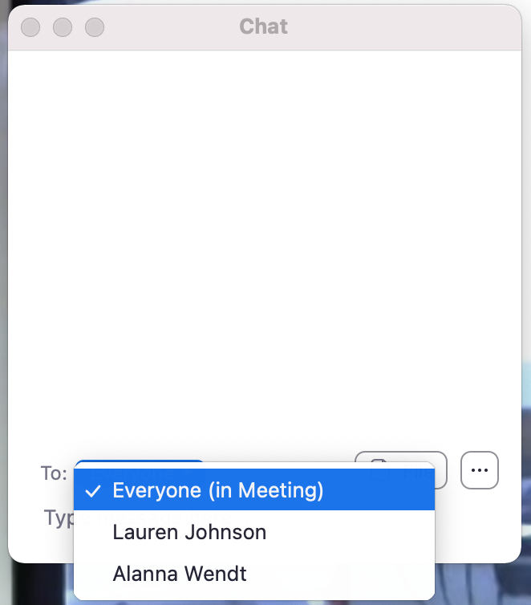
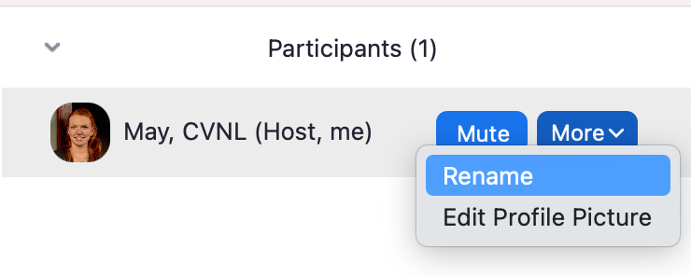
Tech Tips
Chat tab: Ask your questions here!
Participants tab: Add your organization’s name to your title
Reactions tab: Share a heart or some applause to show your reactions throughout the presentation
Recording & slides will be available after the presentation at cvnl.org

Slide 7
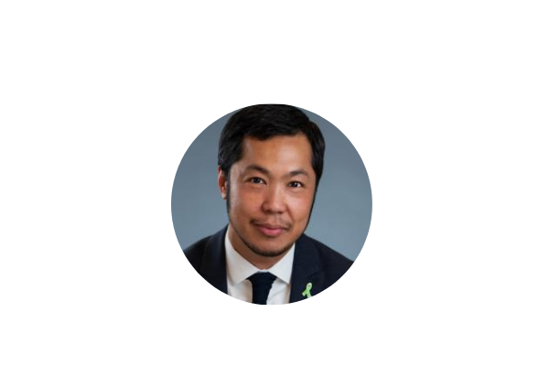
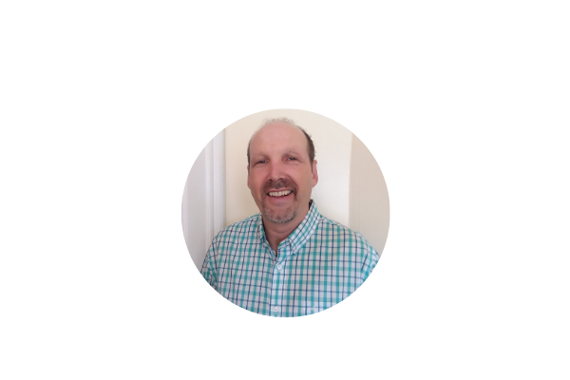
Mental Health and Employee Well-Being During Covid-19
Dr. Jei Africa
Director, Behavioral Health & Recovery Services
Marin County Health and Human Services
Kim Brown Sims, RN
CEO & Founder
KBS Leadership Consulting
Board President, Mentis Napa
Rob Weiss, LCSW
Executive Director
Mentis Napa
Recording & slides (English/Spanish) will be available at cvnl.org

Slide 8
Dr. Jei Africa
Director, Behavioral Health & Recovery Services
Marin County Health and Human Services

Slide 9
LAND ACKNOWLEDGEMENT
Marin sits upon Me-wuk (Coastal Miwok); all of us in the US are on indigenous land.
Jei Africa at jafrica@marincounty.org

Slide 10
Jei Africa at jafrica@marincounty.org

Slide 11
Ability to cope with and plan amidst ambiguity
Bring calm in the midst of uncertainty
Ability to move teams step-by-step when the end point is not yet known
Leadership during a crisis
Jei Africa at jafrica@marincounty.org

Slide 12
Vulnerability
Vulnerability here does not mean being weak or submissive. To the contrary, it implies the courage to be yourself. It means replacing “professional distance and cool” with uncertainty, risk, and emotional exposure. Opportunities for vulnerability present themselves to us at work every day.
https://hbr.org/2014/12/what-bosses-gain-by-being-vulnerable
Jei Africa at jafrica@marincounty.org

Slide 13
What we’ve in done in BHRS
Increased communication
Be clear about what you know/don’t know and what you are working on and what is on your mind
Shift from monthly to weekly (brief) meetings on Fri at 11 am
Engaged with staff to develop strategies to care for themselves and others
Meditation moments, Mindfulness check-in, chair yoga, Reflective Space, after hour (virtual) socials, book clubs, affinity groups, monthly challenges
Normalize (“it’s okay not to be okay”) and offer resources (to re-energize and re-engage)
Jei Africa at jafrica@marincounty.org

Slide 14
Reflective Space
Guiding questions to help discussions:
Why are we having these conversations? What’s the intention?
What’s the impact of my role (positional power) and how can it influence staff and/or discussion?
How is this discussion connected to our organizational values and our commitment to our clients and community?
What resources can I share to help support staff and/or to direct those who are interested to learn more about what we talked about?
Please ask permission for use.
Jei Africa at jafrica@marincounty.org

Slide 15
Kim Brown Sims, RN
CEO & Founder
KBS Leadership
Board President, Mentis Napa

Slide 16
The Greatest Gift
Impact: The World in Which We Live
Kim Brown Sims, MBA, RN, FACHE
Executive Board Chair
Rob Weiss, LCSW
Executive Director

Slide 17
Objectives
Discuss the physiologic responses to stress
Describe the tenets of Mind Body Medicine techniques to alleviate stress and anxiety
Understand the importance of acknowledging impacts from the pandemic, social and civic unrest and the financial crisis
Define moral injury, distress, and residue for essential workers
Take-away leadership strategies to engage and support staff

Slide 18
Physiologic Response to Stress

Slide 19
Techniques to Alleviate Stress
Peace. It does not mean to be in a place where there is no noise, trouble or hard work. It means to be in the midst of those things and still be calm in your heart.
-Unknown

Slide 20
Moral Injury, Distress and Residue
Moral injury can happen to someone not only by directly inflicting harm, but also by witnessing it happening, hearing about it, or surviving being harmed.
Moral distress is the inability of a moral agent to act according to his or her core values and perceived obligations due to internal and external constraints.
Moral residue is long-lasting and becomes powerfully integrated into one's thoughts and views of the self. It is this aspect of moral distress—the residue that remains—that can be damaging to the self and one's career, particularly when morally distressing episodes repeat over time. It is characterized by three components: emotional exhaustion, depersonalization (loss of self), and personal accomplishment.

Slide 21
Acknowledgment

Slide 22
Rob Weiss, LCSW
Executive Director
Mentis Napa

Slide 23
Leadership Strategies
Actively listen.
Acknowledge feelings being expressed and situations as they are being seen.
Recognize that the best a person has to give in the moment may be less than what they are capable of and have exemplified in the past.
Engage in dialogue, mirroring concerns and collaborating to find an in-the-moment solution.
Act with empathy, grace, and kindness not only for others, but for yourself as well.
Be a hero for the heroes on the front line. It can be as simple as uttering four words, How can I help?
And then listen to the answer.

Slide 24
The Greatest Gift Is You
Success as a leader is not having all the answers, not putting up a shield to appear strong, not dictating the direction but rather, asking for opinions to gather answers, being vulnerable and acknowledging your own concerns and doubts.
It’s a recognition that the key to success is taking it day-by-day, sometimes, minute-by-minute, and that making decisions with an open heart usually results in the right decision.

Slide 25
What We are Doing at Mentis
Begin with acknowledging to staff challenges of time we are living in, validate emotional/mental impact as providers-how do we self-regulate as staff to be available to others-self care practices for stress/trauma-staff has their own personal issues
Open conversation/mutual support from both management to direct service staff and peer to peer- provide setting/opportunity for this to happen
Encouragement and reminders about the value of our work – service to others/reasons why we work for non-profit organizations
Clear communication around staff expectations and agency response to COVID

Slide 26
Organizational Practices
Assessing staff capacity to perform their job on an individual basis using program managers-range in how people respond
Coming up with contingency/coverage plans as needed based on staff assessment-adjusting caseloads/what does staff need
Given most work is remote, making sure staff has home office space that is functional-differences from being in the office
Ongoing dialog with staff as situation is dynamic and constantly changing-attending to staff stressors
At leadership level use a flexible approach-model for team good mental health practices-engage in creative problem solving

Slide 27
Final Thoughts
Common sense-making adjustments as needed
Continue to assess/gauge staff emotional health
Recognizing the emotional/mental toll of a prolonged pandemic- watch for fatigue
Keep team informed, stay connected
Critical that staff “feels supported”

Slide 28
Q&A Session:
At this time we would like to invite your additional questions.
Time permitting we hope to respond to everyone’s inquiries
Click the “Chat” icon and type your questions here

Slide 29
Additional Resources
Center for Volunteer & Nonprofit Leadership
cvnl.org/covid-landing-page
Frontline Workers Counseling Project (therapy resource for frontline workers)
https://genesishealinginstitute.org/soul-refuge-team (support for racial trauma)
Mental Health & Wellness: The Best Apps & Resources For Self Care (support for BIPOC & LGBTQ+)
Articles
Strategies for Building an Organization with Soul
Healing Justice Guidance to Philanthropy During COVID-19, the Uprisings, and Beyond
From Trauma to Transformative Futures: Four Dimensions
How to Challenge White Supremacy Through Rest
Recording & slides (English/Spanish) will be available at cvnl.org

Slide 30
Additional Resources
NAMI Marin (National Alliance on Mental Illness):
https://www.marinhhs.org/suicide-prevention
https://www.namimarin.org/covid-19-resource-guide
Center for Mind-Body-Medicine
https://cmbm.org/onlinegroup/
Marin County Health and Human Services
https://www.marinhhs.org/coping-covid-19 (Self-Care Resources and Videos)
https://www.marinhhs.org/sites/default/files/files/servicepages/2020_05/self-care_advice_for_health-care_providers_during_covid-19_4-22-20.pdf (Handout on Self-Care)
Recording & slides (English/Spanish) will be available at cvnl.org

Slide 31
Additional Resources
Trauma Informed Approach
https://blogs.cdc.gov/publichealthmatters/2018/07/trauma-care/
https://store.samhsa.gov/product/SAMHSA-s-Concept-of-Trauma-and-Guidance-for-a-Trauma-Informed-Approach/SMA14-4884
https://store.samhsa.gov/product/Preventing-and-Managing-Stress/SMA14-4873
https://www.cdc.gov/cpr/infographics/6_principles_trauma_info.htm
Recording & slides (English/Spanish) will be available at cvnl.org

Slide 32
CVNL Upcoming Learning Opportunities
Peer Learning Networks
Convened and facilitated virtually by CVNL staff members, these supportive networks of like-minded nonprofit professionals.
Fundraising & Marketing (Joint Meeting) – dbell@cvnl.org
January 27, 1:00pm-2:00pm
Volunteer Services – etokolahi@cvnl.org
February 3,10am-11am
Learn more at: cvnl.org/peer-learning-networks
Excellence in Leadership Program (ELP) March – May 2021
Apply now, Early-Bird discount of $100 if received by 1/29. Learn more and apply here.
Dare to Lead™
March – May 2021
Nationally certified program based on the work of Dr. Brené Brown. Apply Now.
Lunch and Learns (FREE)
February 5 – FAQs about Board Governance Register Here.
Featured Event: February 17, Your Brain on Story – Improving Your Communication Power and Success
Great for fundraisers and marketing professionals! Register Here.
Recording & slides (English/Spanish) will be available at cvnl.org

Slide 33
Support for this webinar generously provided by…
Ginnie & Peter Haas Jr. Family Fund,
Marin Community Foundation, Community Foundation Sonoma County, and Solano Community Foundation
33

Slide 34
Thanks for Joining Us!
Dr. Jei Africa
Director, Behavioral Health & Recovery Services
Marin Health and Human Services
Kim Brown Sims
CEO & Founder
KBS Leadership Consulting
Rob Weiss
Executive Director
Mentis Napa
Recording & slides (English/Spanish) will be available at cvnl.org

